Slide 1
Introduction to Twine
Using Harlowe

Slide 2

What is Twine?
An open-source interactive fiction tool
Programming is not required to make a great story
Can be enhanced with variables and logic
Stories are automatically published to HTML, allowing it to be posted anywhere

Slide 3
Why learn Twine?
Serves as a strong introduction to programming fundamentals
Learn the basics of variables, conditionals, and functions

Slide 4
Getting Started
Visit twinery.org
Either download the twine program or use it online, any option will do
If you opt to download the software, follow the installation instructions and open the program

Slide 5
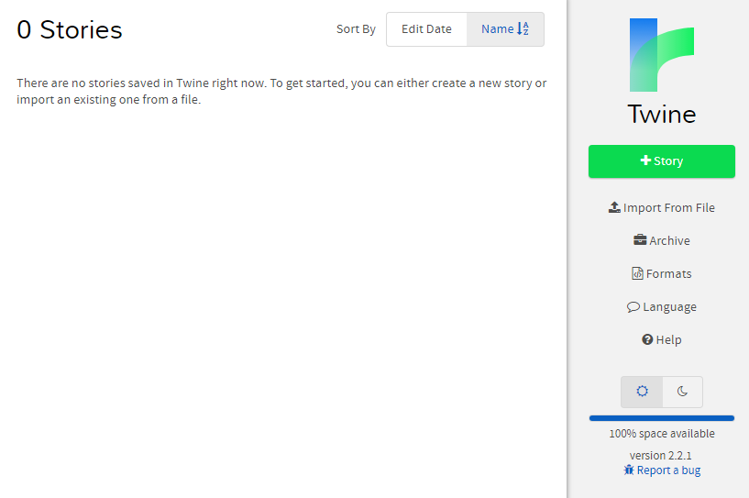
Making a new story
Click +Story
Give it a name
Click +Add

Slide 6
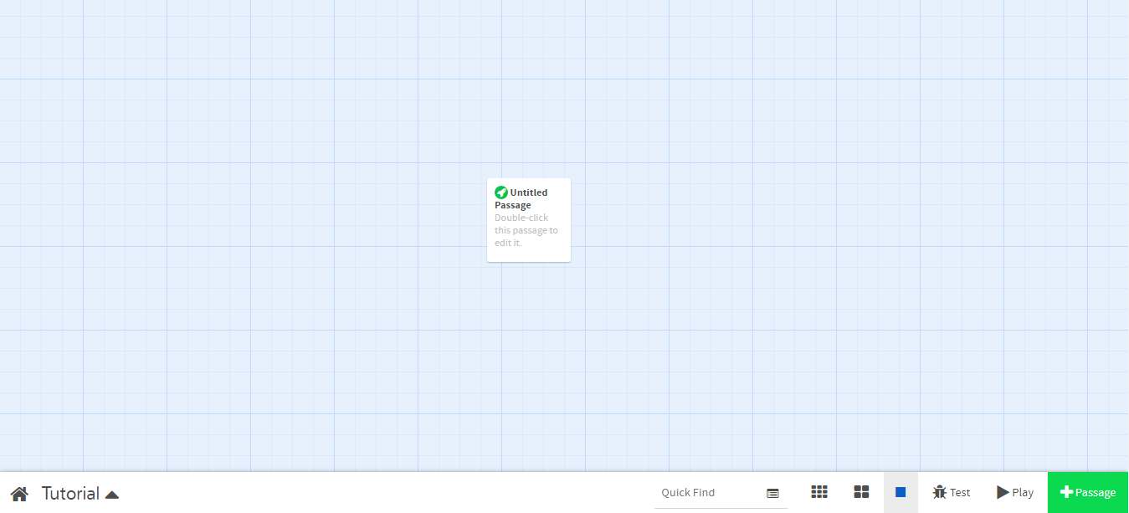
The Interface is where you edit passages

Slide 7
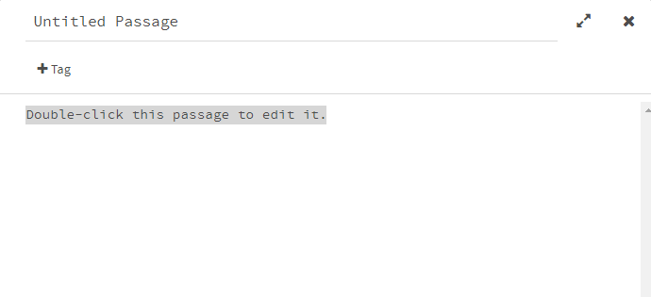
Editing Passages
Passages are the scenes of your story
Describe what is going on, add dialogue, and write story elements

Slide 8
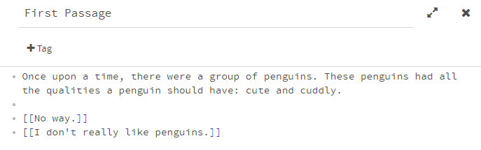
Connecting Passages
Link passages to allow your story to branch out
Surround text by two pairs of square brackets: [[text]]
You may edit the branching passages as well

Slide 9
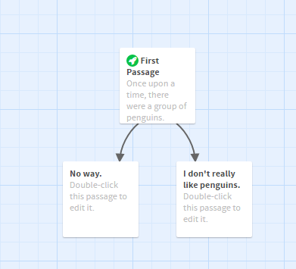
Basic Twine story with branching passages

Slide 10

Play your story

Slide 11
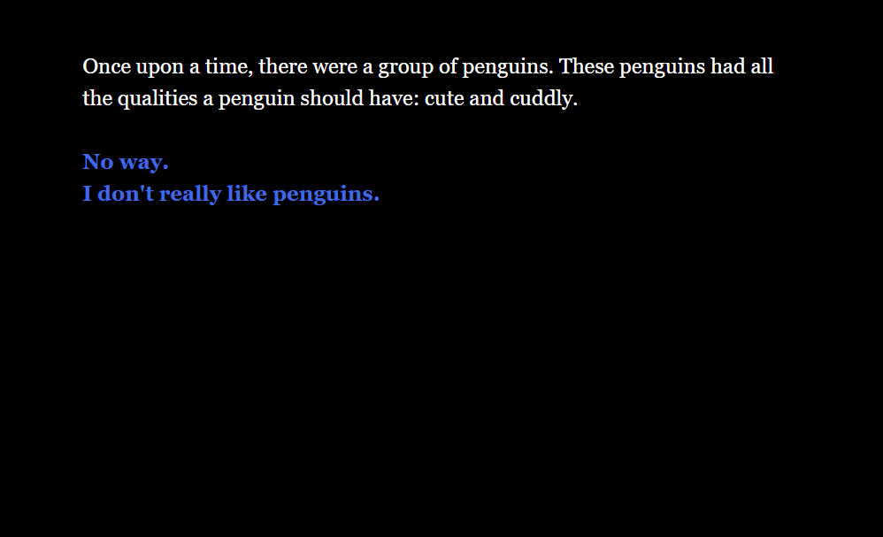
Blue text links to another passage

Slide 12
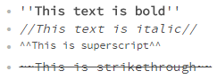
Text Formatting
You may format text differently by surrounding it with a pair of special characters

Slide 13
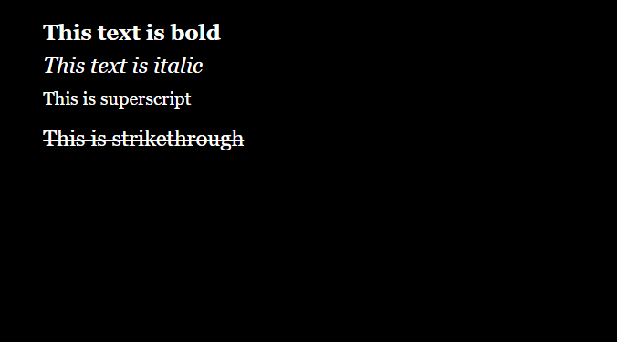
Formatted text in action

Slide 14
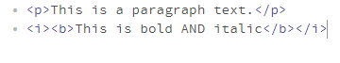
Text Formatting with HTML
In addition to special characters, you may surround text in special HTML tags
These tags may be used later on for CSS styling

Slide 15
Programming in Twine

Slide 16
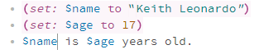
Variables
Variables contain values to be used by the passages
They can hold strings, numbers, booleans, etc.
Variable names start with a $ (e.g. $number, $myvariable)
Create a variable using the (set:) macro.

Slide 17
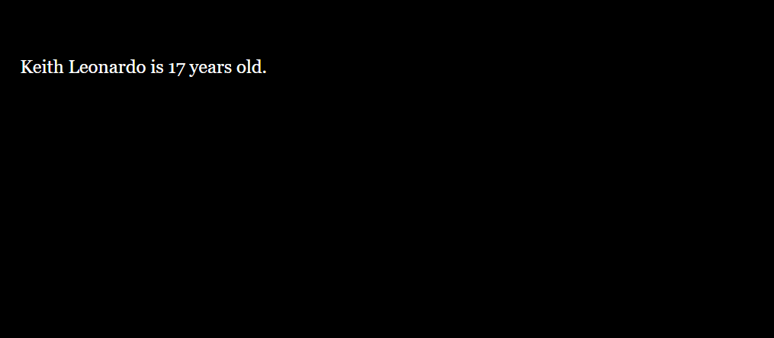
Setting and using variables

Slide 18
Macros
Perform a particular task, essentially a function
Format -- (macro-name: macro-value)
macro-values may include strings, numbers, booleans, and even the return value of other macros.
(print: “my first macro!”)

Slide 19

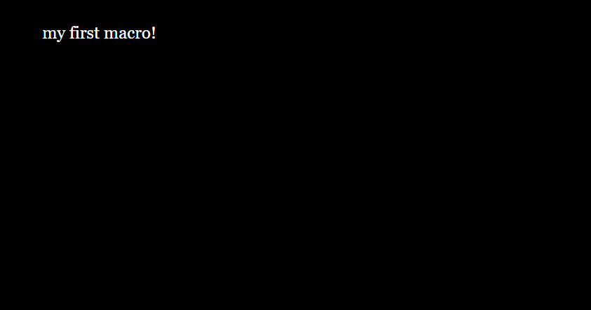
Visit twinery.org/wiki/harlowe:macro_markup for more macros

Slide 20
Hooks
They indicate that a specific span of text is special in some way, denoted by text between square brackets [sample text]
Hooks can be attached to macros and variables to alter the text within it.
(text-colour: blue)[Some text]

Slide 21
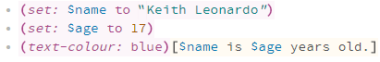
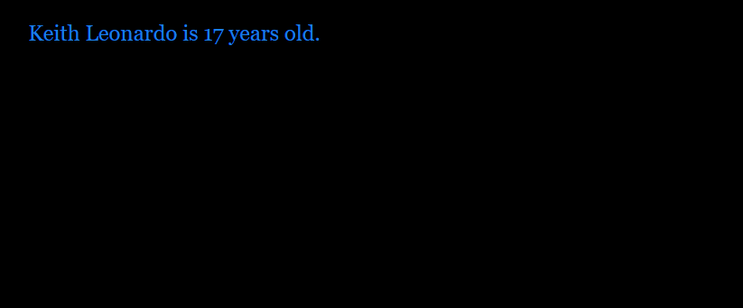
Hooks in action

Slide 22
User Input (prompt:)
Set a variable to an input value by the user using the (prompt:) macro
The macro takes two inputs: the prompt and default value.
(prompt: “What is your name?”, “”)

Slide 23
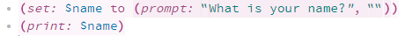
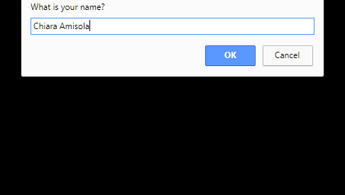
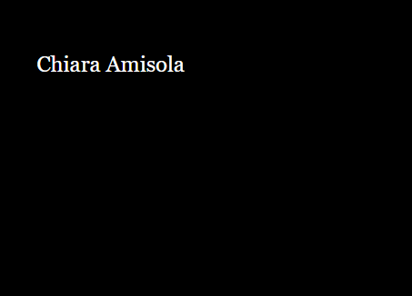
Set the user input to a variable then display it

Slide 24
Logical Macros
The (if:), (else-if:), and (else:) macros allows the story to have decision making elements.
A whole conditional block is contained in curly braces {}
Conditionals toggle a hook’s visibility depending on whether the output is true or false.

Slide 25
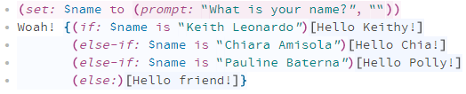
A basic conditional block in action (note the curly braces)

Slide 26

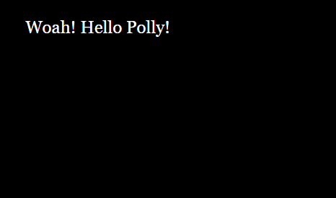
A basic conditional block in action

Slide 27
Done with Twine basics!

